Slide 1
Feistel Cipher Structure
This lecture slide is mainly based on the power point slides by Professor Lawrie Brown.
Notes:
Zili Shao

Slide 2
Modern Block Ciphers
Modern Block Ciphers are the most widely used types of cryptographic algorithms
Provide secrecy and/or authentication services
DES (Data Encryption Standard)
CEG 260, Meilin Liu
Notes:
Zili Shao
Modern block ciphers are widely used to provide encryption of quantities of information, and/or a cryptographic checksum to ensure the contents have not been altered. We continue to use block ciphers because they are comparatively fast, and because we know a fair amount about how to design them.

Slide 3
Block vs Stream Ciphers
Block ciphers process messages in blocks, each of which is then en/decrypted
Like a substitution on very big characters
  64-bits or more
Stream ciphers process messages a bit or byte at a time when en/decrypting
Many modern ciphers are block ciphers
CEG 260, Meilin Liu
Notes:
Zili Shao
Block ciphers work a on block / word at a time, which is some number of bits. All of these bits have to be available before the block can be processed. Stream ciphers work on a bit or byte of the message at a time, hence process it as a “stream”.

Slide 4
Block Cipher Principles
Most symmetric block ciphers are based on a Feistel Cipher Structure
Block ciphers look like an extremely large substitution
Would need table of 2⁶⁴ entries for a 64-bit block
Instead create from smaller building blocks
Using idea of a product cipher
CEG 260, Meilin Liu
Notes:
Zili Shao
An arbitrary reversible substitution cipher for a large block size is not practical, however, from an implementation and performance point of view. In general, for an n-bit general substitution block cipher, the size of the key is n x 2^{n}. For a 64-bit block, which is a desirable length to thwart statistical attacks, the key size is 64 x 2⁶⁴ = 2⁷⁰ = 10²¹ bits.

Slide 5
Diffusion and Confusion
The terms were introduced by Claude Shannon.
They are two basic building blocks for any cryptographic system.
CEG 260, Meilin Liu
Notes:
Zili Shao

Slide 6
Diffusion and Confusion
Diffusion: One bit change in the plaintext affect many bits of ciphertext digits, which is equivalent to saying that each ciphertext bit is affected by many plaintext bits.
CEG 260, Meilin Liu
Notes:
Zili Shao

Slide 7
Diffusion and Confusion
Confusion seeks to make the relationship between the statistics of the ciphertext and the value of the encryption key as complex as possible, so make it hard to deduce the key.
CEG 260, Meilin Liu
Notes:
Zili Shao

Slide 8
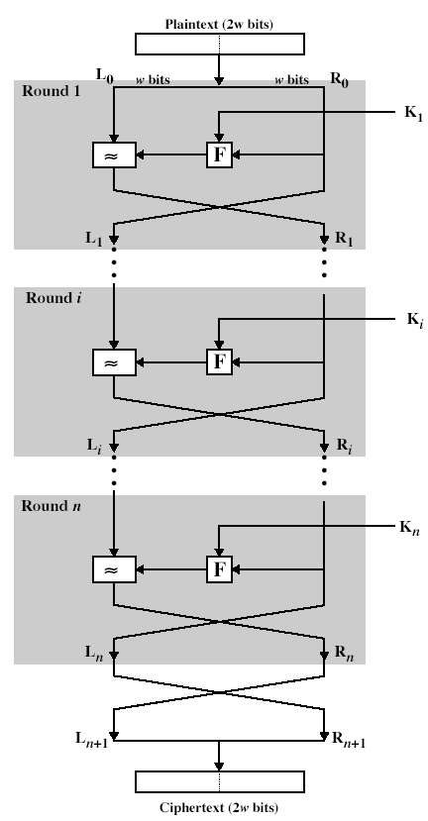
Feistel Cipher Structure
CEG 260, Meilin Liu
Notes:
Zili Shao

Slide 9
Feistel Cipher Structure
Input: 2*w bits (L0, R1)
L1=R0, R1=L0 XOR F(R0, K1) K1 is the first subkey.
Li=Ri-1; Ri=Li-1 XOR F(Ri-1, Ki)
One key to generate n subkey by
Some find of shifting
2w
L₀
R₀
K₁
XOR
F
Round 1
L₁
R₁
CEG 260, Meilin Liu
Notes:
Zili Shao

Slide 10
Feistel Cipher Structure
L_{i-1}
R_{i-1}
K_{i}
XOR
F
Round i
L_{i}
R_{i}
CEG 260, Meilin Liu
Notes:
Zili Shao

Slide 11
Feistel Cipher Structure
Is that necessary that function F need to invertible?
How to decrypt the cipher text?
XOR operation: Commutativity, Associativity
a XOR a = 0
a XOR 0 = 0
a XOR 1 = a’
a XOR k = b
b XOR k =a
CEG 260, Meilin Liu
Notes:
Zili Shao

Slide 12
Feistel Cipher Design Features
Block size
  Larger block sizes mean greater security but reduced encryption/decryption speed for a given algorithm
Key size
  Larger key size means greater security but may decrease encryption/decryption speeds
Number of rounds
  The essence of the Feistel cipher is that a single round offers inadequate security but that multiple rounds offer increasing security
Subkey generation algorithm
  Greater complexity in this algorithm should lead to greater difficulty of cryptanalysis
Round function F
  Greater complexity generally means greater resistance to cryptanalysis
Fast software encryption/decryption
  In many cases, encrypting is embedded in applications or utility functions in such a way as to preclude a hardware implementation; accordingly, the speed of execution of the algorithm becomes a concern
Ease of analysis
  If the algorithm can be concisely and clearly explained, it is easier to analyze that algorithm for cryptanalytic vulnerabilities and therefore develop a higher level of assurance as to its strength
© 2020 Pearson Education, Inc., Hoboken, NJ. All rights reserved.
Notes:
The exact realization of a Feistel network depends on the choice of the following
parameters and design features:
• Block size: Larger block sizes mean greater security (all other things being
equal) but reduced encryption/decryption speed for a given algorithm. The
greater security is achieved by greater diffusion. Traditionally, a block size of
64 bits has been considered a reasonable tradeoff and was nearly universal in
block cipher design. However, the new AES uses a 128-bit block size.
• Key size: Larger key size means greater security but may decrease encryption/
decryption speed. The greater security is achieved by greater resistance to
brute-force attacks and greater confusion. Key sizes of 64 bits or less are now
widely considered to be inadequate, and 128 bits has become a common size.
• Number of rounds: The essence of the Feistel cipher is that a single round
offers inadequate security but that multiple rounds offer increasing security.
A typical size is 16 rounds.
• Subkey generation algorithm: Greater complexity in this algorithm should
lead to greater difficulty of cryptanalysis.
• Round function F: Again, greater complexity generally means greater resistance
to cryptanalysis.
There are two other considerations in the design of a Feistel cipher:
• Fast software encryption/decryption: In many cases, encryption is embedded in
applications or utility functions in such a way as to preclude a hardware implementation.
Accordingly, the speed of execution of the algorithm becomes a
concern.
• Ease of analysis: Although we would like to make our algorithm as difficult as
possible to cryptanalyze, there is great benefit in making the algorithm easy to
analyze. That is, if the algorithm can be concisely and clearly explained, it is
easier to analyze that algorithm for cryptanalytic vulnerabilities and therefore
develop a higher level of assurance as to its strength. DES, for example, does
not have an easily analyzed functionality.

Slide 13
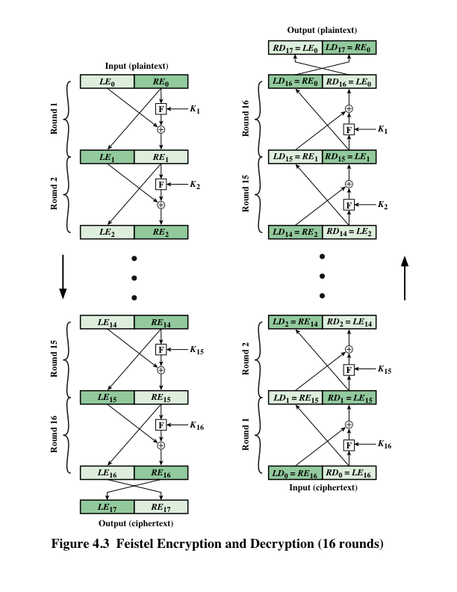
Feistel Cipher
Encryption and
Decryption
Notes:
The left-hand side of Figure 4.3 depicts the structure
proposed by Feistel. The inputs to the encryption algorithm are a plaintext block of
length 2w bits and a key K . The plaintext block is divided into two halves, LE₀ and RE₀ .
The two halves of the data pass through n rounds of processing and then combine to
produce the ciphertext block. Each round i has as inputs LE_{i-1} and RE_{i-1} derived from
the previous round, as well as a subkey K_{i} derived from the overall K . In general,
the subkeys K_{i} are different from K and from each other. In Figure 4.3, 16 rounds
are used, although any number of rounds could be implemented.
All rounds have the same structure. A substitution is performed on the left half
of the data. This is done by applying a round function F to the right half of the data
and then taking the exclusive-OR of the output of that function and the left half of the
data. The round function has the same general structure for each round but is parameterized
by the round subkey K_{i} . Another way to express this is to say that F is a function
of right-half block of w bits and a subkey of y bits, which produces an output value
of length w bits: F (RE_{i} , K_{i+1} ). Following this substitution, a permutation is performed
that consists of the interchange of the two halves of the data. This structure is a particular
form of the substitution-permutation network (SPN) proposed by Shannon.

